Slide 1

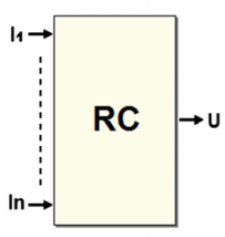
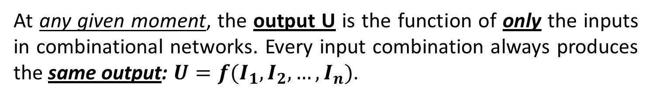
It is very rare for a digital device to be based only on combinational networks. In a real situation, it is important to have devices that can memorize data, generate sequences, and respond to conditions that change over time.
At any given moment, the output U is the function of only the inputs in combinational networks. Every input combination always produces the same output: $U=f(I_{1},I_{2},…,I_{n})$.

Slide 2
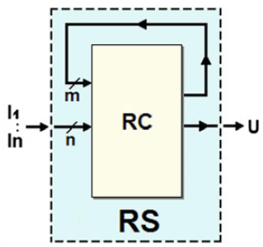
A sequential network does not follow this rule. The same input combination can generate different outputs when applied at different moments.
We can obtain a sequential network by starting with a combinational network and bringing one or more of its outputs into the inputs, as seen in the figure above. This type of connection is called feedback.

Slide 3

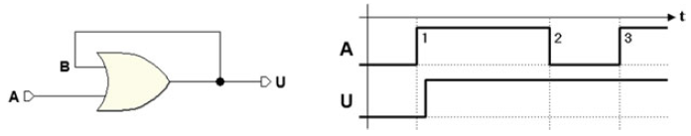
Let’s look at this simple example of a sequential network that uses the OR function, which as we know is a combinational network.
Let’s construct a feedback by bringing the output U to one of the two inputs (B), as in the following figure:
Let’s suppose that A and U (and therefore B) are initially equal to 0. This is described in the timing diagram:

Slide 4
If we force input A to 1 at a certain moment, the output will go to 1. If we reduce input A to zero, this should also force output U to zero, but actually, this does not happen. Because of the feedback connection between U and B, output U remains forced at 1 for any input value A so it is impossible to get it back to zero.
We can say that the network has memorized the value 1. This is no longer a combinational network but a sequential one, where the output value depends on the history of the inputs.
We can no longer describe how it works through a truth table like we did with combinational networks.

Slide 5
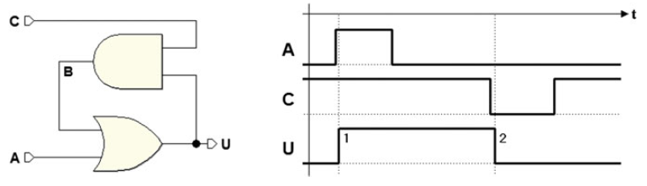
A simple sequential network can be used to store an information bit, i.e., to memorize both the value 0 and 1.
A potential change is shown in the figure below, where an AND gate was inserted in the feedback loop and the input C was added.
The AND gate and input C were added to establish or remove the connection between U and B.
If C = 1 the network will behave as before since every variation of U is transferred through the AND gate on B (B = U · 1 = U).
If C = 0, then B is at 0, regardless of the value of U (B = U · 0 = 0).

Slide 6
In the timing diagram in the figure, we assume that we start with input A and output U at 0 and with input C at 1.
Then, the activation of the input A forces the output to 1. The new value U = 1, brought from the AND gate on input B of the OR, makes it so that further variations of A can no longer change the output. We have memorized a bit at 1.

Slide 7
To force the output U to 0, we will have to open the feedback loop by applying the value 0 to input C, as shown in the timing diagram. Forcing the output to zero memorizes a bit at 0. Further variations of C do not change the situation.

Slide 8
In this case, input A produces the effect of memorizing 1 in the output, which happens when it is brought to 1. This is called an active-high input, that is, it does its job when it is brought to 1 and is inactive when it is at 0.
Input C has the job of memorizing a 0, which happens when it is brought to 0. We say that this input at 0 is active-low and when it is inactive it is at 1.

Slide 9
With this sequential network, we are able to memorize a bit whose value is maintained until a new value is memorized. This is one of the ways to create an elementary memory cell, also called “flipflop”.
Flip-flops are the basic logical elements generally used to build sequential digital systems.

Slide 10
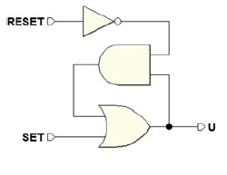
Now let’s try to slightly modify the network. To achieve the classic elementary memory cell called Set-Reset flip-flop, we make the following changes. Let’s:
add a NOT before input C, for memorizing the zero.
call the new input we obtain RESET (it brings the output to 0).
change the name of input A to SET (it brings the output to 1).
change the name of output U to Q (to follow a naming tradition).

Slide 11
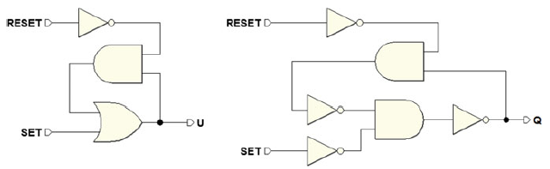
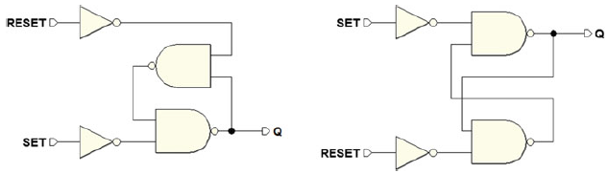
To continue transforming it, we apply De Morgan’s theorem and substitute the OR with an AND (in the figure at the right).
The NOTs directly following the ANDs suggest that we should use the NANDs to get the network below called: Set-Reset flip-flop

Slide 12

We saw how to derive the sequential structure called the Set-Reset flip-flop. This is one of many flip-flops used to memorize a bit of information.
Flip-flops are fundamental blocks used to build more complex sequential networks. We classify the flip-flops according to their “logical type” and to their “command type”
The type of flip-flop whose function is to activate the output (Set it) or deactivate it (Reset it) is the logical Set-Reset.
We will examine other logical types, such as
D (Delay), which memorizes the output value of the unique input D
JK which allows the output’s state to reverse.
Logical type T that derive from JK.

Slide 13
As we will see, the logical type is described by its function table, which indicates the output values in function of the logical inputs, that is, the inputs that characterize the logical type of flip-flop and that give it its name.
The command type describes input behavior, which comes in three forms: direct, level-enabled, or edge-triggered.
In the case of direct command, logical input action is not subordinated to any other enable or synchronization input but it directly controls the behavior of the flip-flop which, in this case, is called “asynchronous”

Slide 14
In the other two cases, there is an added input that enables/disables logical inputs.
Enabling can happen simply as a function of the logical level of this added input (level-enabled command),
when it presents a logical level transition (edge-triggered command).
In this case, the flip-flop is called “synchronous.”
Let’s turn our attention to direct command types. Before we begin to deal with other types of commands, we will need to examine some important concepts like initialization and synchronization of sequential networks.

Slide 15


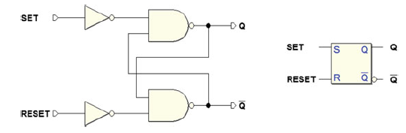
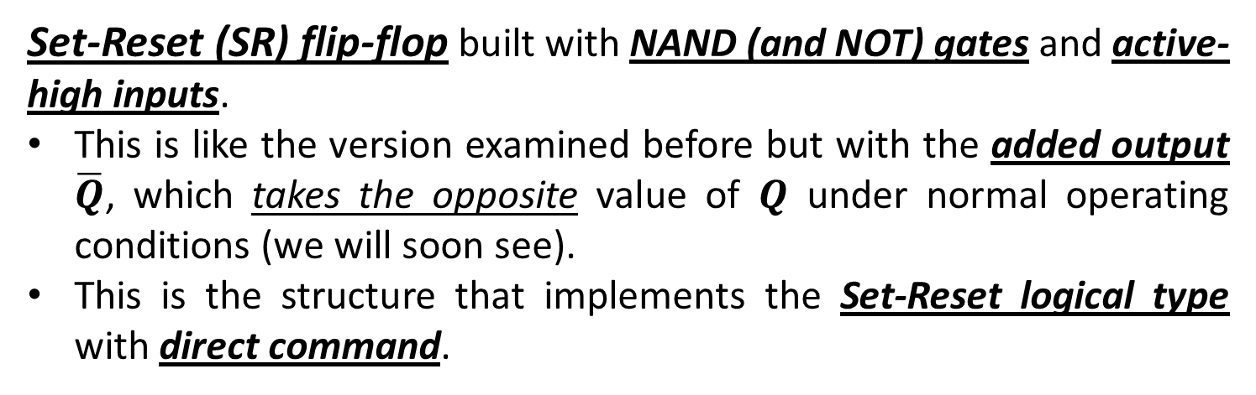
Now, let’s look at the three types of direct commands: SR, D, and JK. The SR type has already been introduced but some of its possible variants will be disscussed.
Set-Reset (SR) flip-flop built with NAND (and NOT) gates and active-high inputs.
This is like the version examined before but with the added output $\overline{Q}$, which takes the opposite value of $Q$ under normal operating conditions (we will soon see).
This is the structure that implements the Set-Reset logical type with direct command.

Slide 16
Drawn on the right side of the figure is the logical symbol that represents this flip-flop in schematics:
This is a sequential network that can memorize a bit.
The activation of the input SET memorizes a 1 in the cell, while the input RESET imposes a 0.

Slide 17
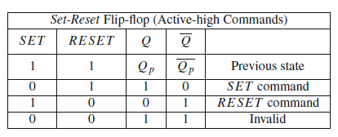
Below function gives both the outputs $\overline{Q}$ and $Q$

Slide 18
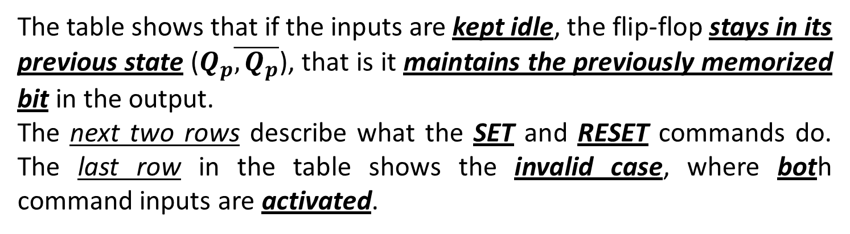
The table shows that if the inputs are kept idle, the flip-flop stays in its previous state ($Q_{p}\overline{, Q_{p}}$), that is it maintains the previously memorized bit in the output.
The next two rows describe what the SET and RESET commands do. The last row in the table shows the invalid case, where both command inputs are activated.

Slide 19
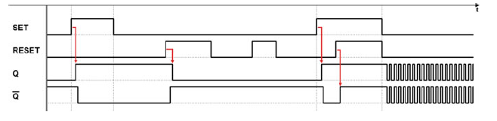
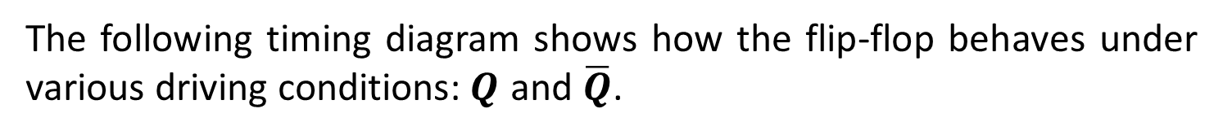
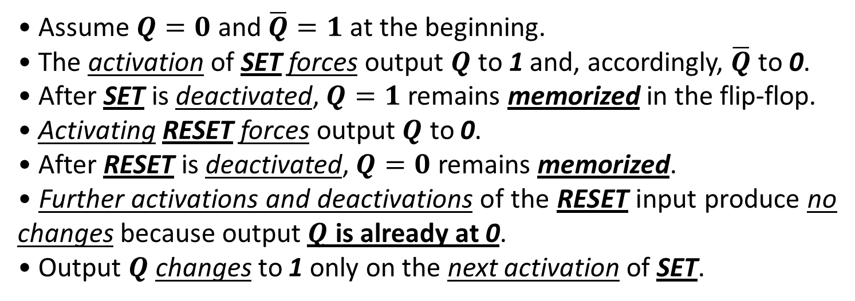
The following timing diagram shows how the flip-flop behaves under various driving conditions:$Q$ and $\overline{Q}$.
• Assume $Q=0$and $\overline{Q}=1$at the beginning.
• The activation of SET forces output $Q$ to 1 and, accordingly, $\overline{Q}$ to 0.
• After SET is deactivated, $Q=1$ remains memorized in the flip-flop.
• Activating RESET forces output $Q$ to 0.
• After RESET is deactivated, $Q=0$ remains memorized.
• Further activations and deactivations of the RESET input produce no changes because output $Q$ is already at 0.
• Output $Q$ changes to 1 only on the next activation of SET.

Slide 20
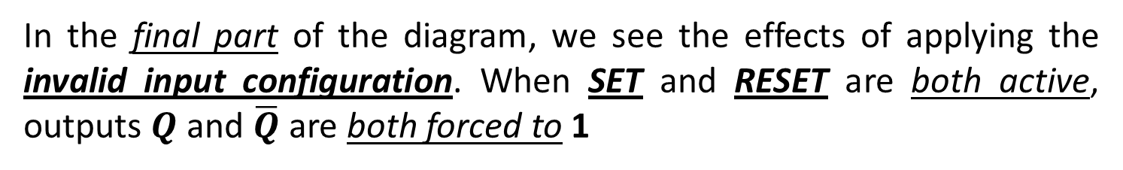
In the final part of the diagram, we see the effects of applying the invalid input configuration. When SET and RESET are both active, outputs $Q$ and $\overline{Q}$are both forced to 1

Slide 21
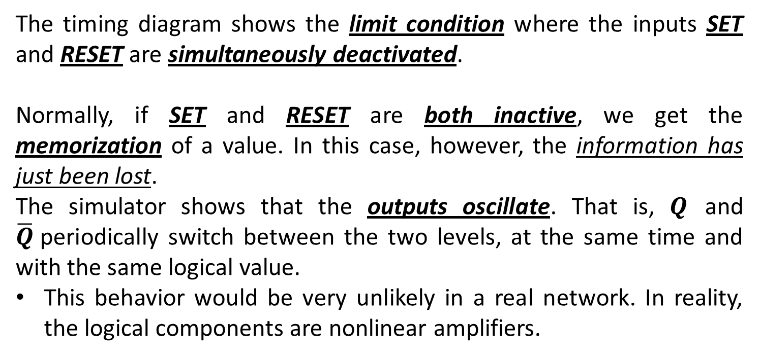
The timing diagram shows the limit condition where the inputs SET and RESET are simultaneously deactivated.
Normally, if SET and RESET are both inactive, we get the memorization of a value. In this case, however, the information has just been lost.
The simulator shows that the outputs oscillate. That is, $Q$ and $\overline{Q}$periodically switch between the two levels, at the same time and with the same logical value.
This behavior would be very unlikely in a real network. In reality, the logical components are nonlinear amplifiers.

Slide 22
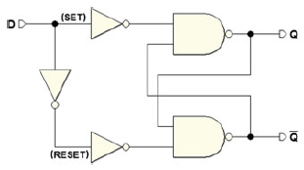
We want one single data input D, rather than two separate SET and RESET controls.
The idea is to simply memorize the bit by submitting it at the input and to avoid the problems related to the invalid configuration.
We get rid of one input by adding a NOT to the SR flip-flop structure with active-high inputs. The data in input D is applied to the SET, while we attach D to the RESET.
The NOT assures that the inputs SET and RESET will never have the same logical level. This prevents the critical condition.

Slide 23
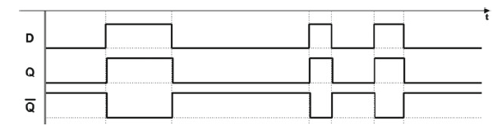
In the timing diagram, output $Q$ always reproduces input D:

Slide 24

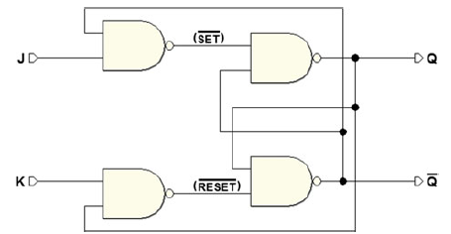
An efficient approach to eliminating the invalid configuration is the JK flip-flop with direct commands.
This circuit derives from the Set-Reset flip-flop with active-low inputs plus two NAND gates, as shown in the figure.
The new inputs are assigned the name J and K

Slide 25
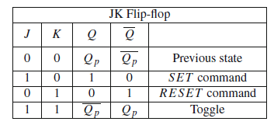
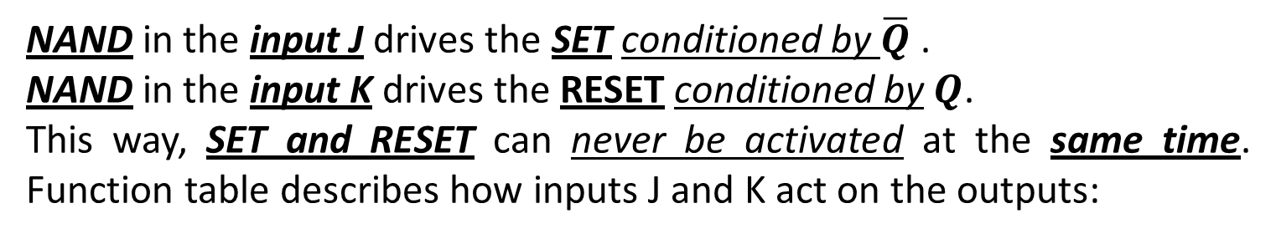
NAND in the input J drives the SET conditioned by $\overline{Q}$.
NAND in the input K drives the RESET conditioned by $Q$.
This way, SET and RESET can never be activated at the same time. Function table describes how inputs J and K act on the outputs:

Slide 26
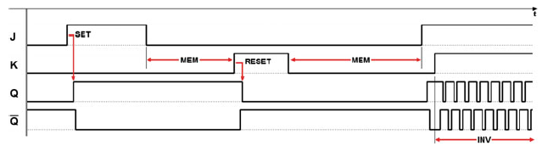
In the first row of the table, J and K are both at 0, so SET
and RESET are at 1,
and the outputs keep the previous value.
In the timing simulation below, we find this input configuration in the “MEM” time intervals:

Slide 27
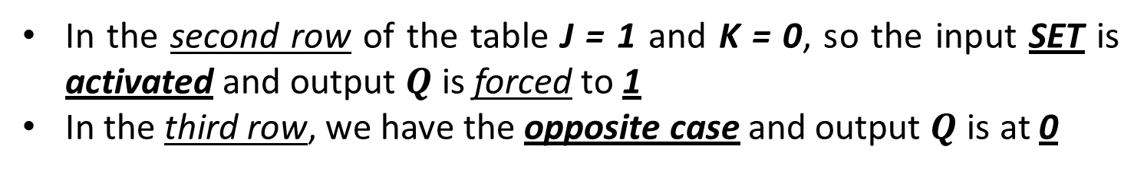
In the second row of the table J = 1 and K = 0, so the input SET is activated and output $Q$ is forced to 1
In the third row, we have the opposite case and output $Q$ is at 0

Slide 28
The JK flip-flop is different from the SR type because the invalid condition in SR is used to accomplish a useful function, the inversion of the output values (as shown in the last line of the table), also known as “toggle”

Slide 29
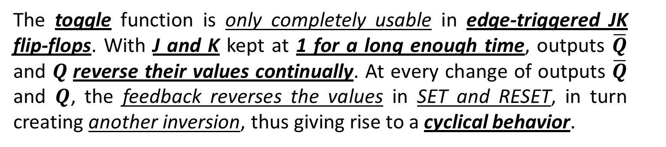
The toggle function is only completely usable in edge-triggered JK flip-flops. With J and K kept at 1 for a long enough time, outputs $\overline{Q}$ and $Q$reverse their values continually. At every change of outputs $\overline{Q}$ and $Q$, the feedback reverses the values in SET and RESET, in turn creating another inversion, thus giving rise to a cyclical behavior.

